Slide 1
Refactoring
Lecturer: Ngo Huy Bien
Software Engineering Department
Faculty of Information Technology
VNUHCM - University of Science
Ho Chi Minh City, Vietnam
nhbien@fit.hcmus.edu.vn

Slide 2

Objectives
To present what is refactoring
To present why refactor system
To present how to refactor system
To use tools for refactoring

Slide 3

Contents

Slide 4

References
Martin Fowler (2019). Refactoring - Improving the Design of Existing Code. 2nd Edition. Addison-Wesley Professional.
Steve McConnell (2004). Code Complete, Second Edition. Microsoft Press.
Martin Fowler et al. (1999). Refactoring: Improving the Design of Existing Code.

Slide 5
Why & What [1]
When you have to add a feature to a program but the code is not structured in a convenient way, first refactor the program to make it easy to add the feature, then add the feature.
Before you start refactoring, make sure you have a solid suite of tests. These tests must be selfchecking.
Refactoring changes the programs in small steps, so if you make a mistake, it is easy to find where the bug is.
Any fool can write code that a computer can understand. Good programmers write code that humans can understand.
The true test of good code is how easy it is to change it.
The whole purpose of refactoring is to make us program faster, producing more value with less effort.

Slide 6
Refactoring [2]
Refactoring is the process of changing a software system in such a way that it does not alter the external behavior of the code yet improves its internal structure.
Makes Software Easier to Understand
Improves the Design of Software
Refactor When You Add Function
Refactor When You Need to Fix a Bug
Refactor As You Do a Code Review

Slide 7
Refactoring
Software productivity and reliability improvement.
Refactoring Improves the Design of Software
Refactoring Makes Software Easier to Understand
Refactoring Helps You Find Bugs
Refactoring Helps You Program Faster
A good design is essential for rapid software development.
With refactoring you still do upfront design, but now you don't try to find the solution. Instead all you want is a reasonable solution.

Slide 8
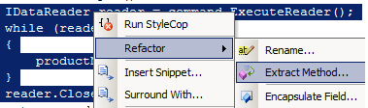
Duplicated Code: same expression in two methods
Extract Method
Turn the fragment into a method whose name explains the purpose of the method.

Slide 9
Replace Method with Method Object
You have a long method that uses local variables in such a way that you cannot apply Extract Method.
Turn the method into its own object so that all the local variables become fields on that object. You can then decompose the method into other methods on the same object.

Slide 10
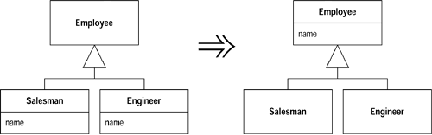
Duplicated Code: same expression in two sibling subclasses
Pull Up Field
Move the field to the super-class

Slide 11
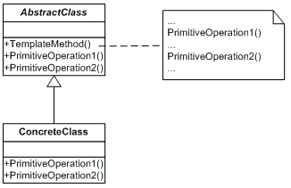
Duplicated Code: similar expression in two sibling subclasses.
Form Template Method
Get the steps into methods with the same signature, so that the original methods become the same. Then you can pull them up.

Slide 12
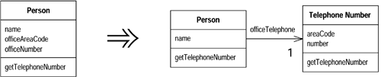
Duplicated Code in two unrelated classes.
Extract Class
Create a new class and move the relevant fields and methods from the old class into the new class.

Slide 13

Long Method
Long Method is a method that is too long, so it is difficult to understand, change, or extend.

Slide 14
Large Class
Large Class means that a class is trying to do too much. These classes have too many instance variables or methods.

Slide 15
Primitive Obsession
Primitive Obsession smell represents a case where primitives are used instead of small classes.

Slide 16
Long Parameter List
Long Parameter List is a parameter list that is too long and thus difficult to understand.

Slide 17
Bad Smells in Code and Refactoring
[Fow99] Martin Fowler, Refactoring: Improving the design of existing code. Addison Wesley, 1999.
Duplicated Code, Long Method, Large Class, Long Parameter List, Divergent Change, Shotgun Surgery
Extract Method, Pull Up Field, Substitute Algorithm, Extract Class, Hide Delegate, Move Method
Human intuition is the key for finding the smells

Slide 18
Bad Code Smells – Taxonomy & Measures
[Man03] M. Mantula, Bad Smells in Software. A Taxonomy and an Empirical Study. Master’s Thesis, 2003.
The Bloaters, The Object-Orientation Abusers, The Change Preventers, The Dispensable
Relating the bad code smells against source code measures.
This method cannot be applied for Primitive Obsession, Divergent Change, Shotgun Surgery.

Slide 19
Architectural Bad Smells
[GPEM09] Joshua Garcia, Daniel Popescu, George Edwards and Nenad Medvidovic, Indentifying Architectural Bad Smells, Proceedings of the 2009 European Conference on Software Maintenance and Reengineering.
Connector Envy, Scattered Functionality, Ambiguous Interfaces and Extraneous Connector
Impact of the smell
Human intuition is the key for finding the smells

Slide 20
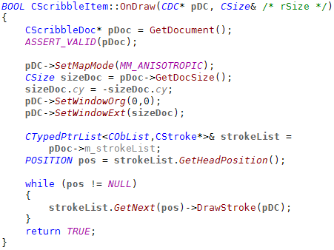
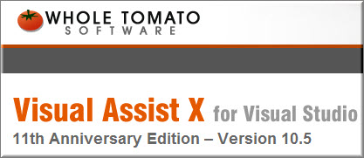
Tools for Refactoring And Producing Readable Code
http://www.wholetomato.com/
http://www.sublimetext.com/

Slide 21

Thank You & See You Again

